Slide 1
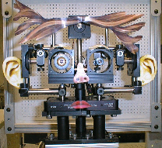
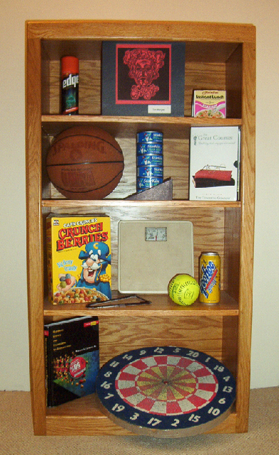
Object Recognition from Photographic Images Using a Back Propagation Neural Network
CPE 520 Final Project
West Virginia University
Daniel Moyers
May 6, 2003

Slide 2
Introduction
Why use neural networks for object recognition?
Neural networks are the key to smart and complex vision systems for research and industrial applications.

Slide 3
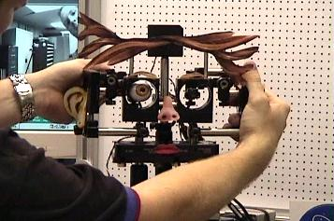
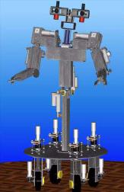
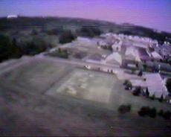
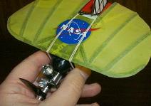
Motivation and Applications
Object Recognition is essential for……
Vision Based
Industrial Robots
Socially interactive robots
Autonomous Flight Vehicles

Slide 4
Background
Object Recognition Concerns
It is necessary to recognize the shape of patterns in an image regardless of position, rotation, and scale
Objects in images must be distinguished from their backgrounds and additional objects
Once isolated, objects can then be extracted from the captured image

Slide 5
Neural Network Paradigms to Consider
Supervised Learning Mechanisms:
Back Propagation –very robust & widely used
Extended Back Propagation: PSRI
- Position, Scale, and Rotation Invariant neural
processing
Unsupervised Learning Mechanisms:
Kohonen network –
- may be used to place similar objects into groups
Lateral inhibition can be used for edge enhancement

Slide 6
Application: Neural Network Type
Back Propagation Network with Momentum
BP is classified under the supervised learning paradigm
BP is Non-recurrent
- learning doesn’t use feedback information
Supervised learning mechanism for multi-layered, generalized feed forward network

Slide 7
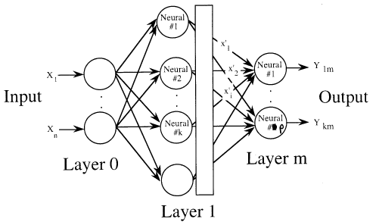
Back Propagation Network Architecture

Slide 8
Back Propagation
Back Propagation is the most well known and widely used among the current types of NN systems
Can recognize patterns similar to those previously learned
Back Propagation networks are very robust and stable
A majority of object/pattern recognition applications use
back propagation networks
Back propagation networks have a remarkable degree of fault-tolerance for pattern recognition tasks

Slide 9
Problem Statement
The goal was to demonstrate the object recognition capabilities of neural networks by using real world objects
Processed photographs of 14 household objects under various orientations were considered for network training patterns
Images were captured and preprocessed to extract object feature data
The back propagation network was trained with nine patterns
The remaining patterns were used to test the network

Slide 10
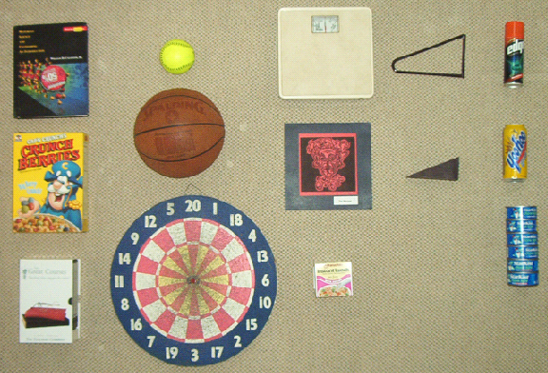
The Experimental Objects
A total of 14 objects to be classified into 5 groups:
Rectangular
Circular
Square
Triangular
Cylindrical

Slide 11
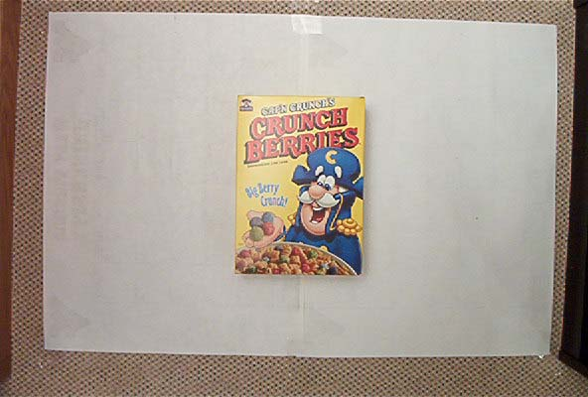
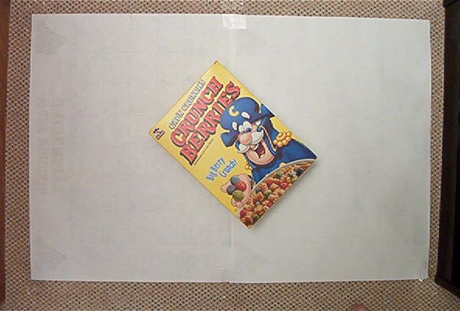
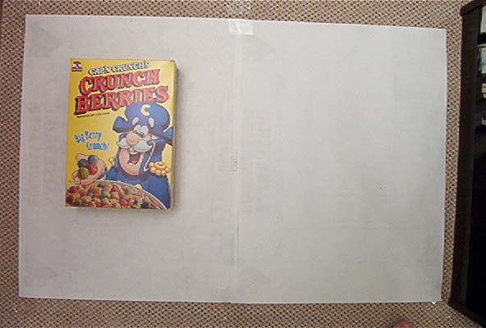
Variance in Position, Rotation and Scale
The Captured Image Sets
0 Degrees
Rotated
Offset

Slide 12
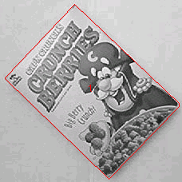
Image Processing:
Preparation for network inputs
Image Tool results for cereal box at 45 deg.

Slide 13
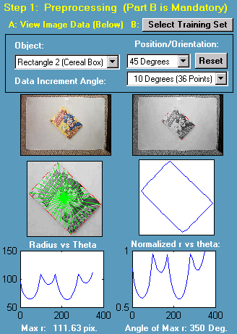
Training Data
Preprocessing section of
the software application
Network Inputs
The inputs to the network
were normalized radius values
Measured from the centroid
of the object to the edge of the
object in increments of 10
degrees

Slide 14
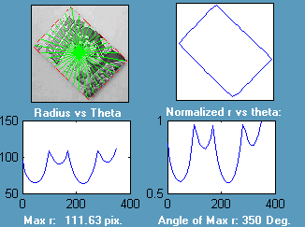
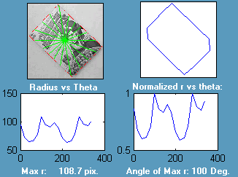
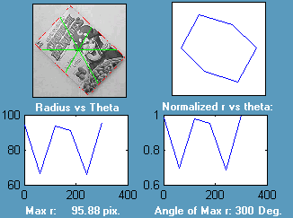
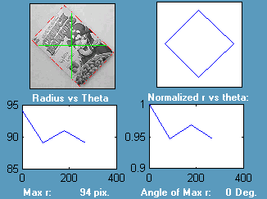
Analysis of Training Data
For Determination of Training Set
10 deg (36 data point)
30 deg (18 data points)
60 deg (6 data point)
90 deg (4 data points)

Slide 15
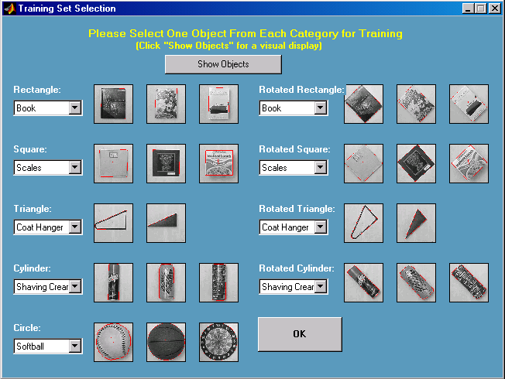
The Training Set Selection Interface
- Nine selections are to be made for training the 9 output neurons:
One object from each group at 0 degrees (5 total)
One object from the non-circular groups at 45 deg. (4 total)

Slide 16
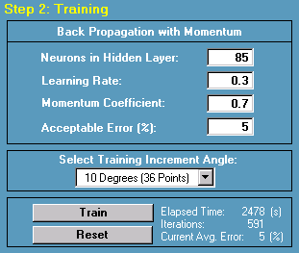
The Training Section
Testing Configuration:
Number of neurons
in hidden layer: 85
Learning rate: 0.3
Momentum Coefficient: 0.7
Acceptable Error: 5 %
Training Increment Angle: 10 deg.

Slide 17
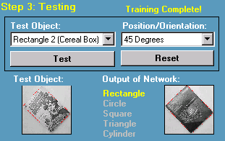
The Testing Section
- After training, the user may test all 36 configurations
based on the results of the 9 training configurations
- Seen to the bottom right, the book was used as the
rectangular training object.
- When the cereal box (bottom left) was tested by the network,
it was correctly determined to be a rectangle at 45⁰.

Slide 18
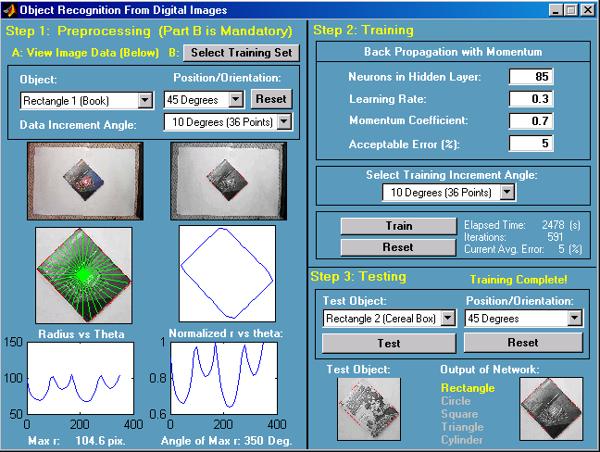
The Entire GUI Configuration

Slide 19
Conclusions
The network was able to successfully classify all of the test objects by object type and orientation.
The average training time for 100% accuracy in successfully classifying all of the test objects was approximately 42 minutes.
Average number of iterations required for training was 552
Once training is complete, testing objects for classification can be performed in real-time.
When the network was trained to within 2% error, the training time was 3.27 hours and 2493 iterations were necessary.
However, 5% acceptable error was sufficient for the network to correctly identify all of the test objects due to similarities among their group

Slide 20
Future Work
Development of a semi-supervised neural
network for humanoid robotics applications
The network will continually grow in size
as the object knowledge base expands
Network training will be modeled after
human learning techniques
The humanoid robot’s neural network will learn new objects and then prompt its trainer to provide a name for each of those objects

Slide 21
Questions?
Thank you for your time!

